Slide 1
Network Fundamentals – Lecture 1

Slide 2
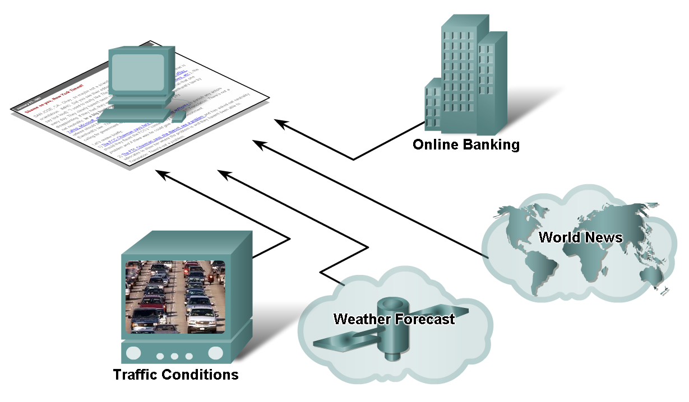
How Networks Impact Daily Life
Networks provide instantaneous communication and supports and improves our lives.

Slide 3
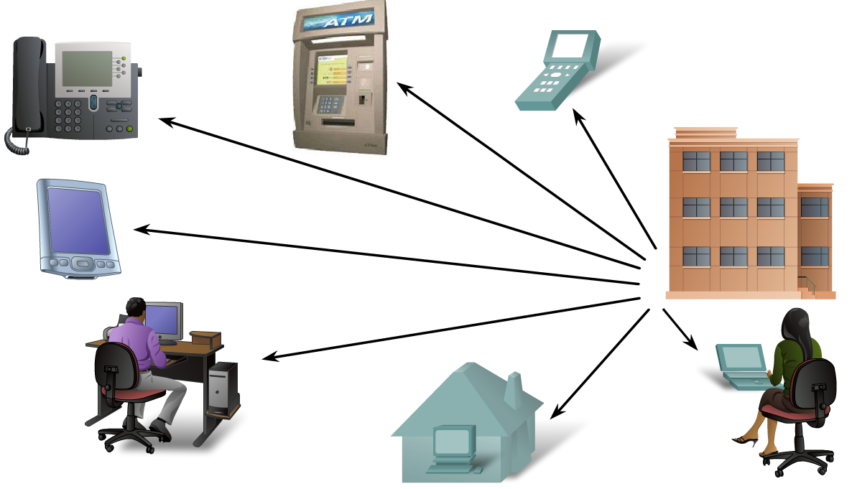
How Networks Impact Daily Life
Communication over networks changes the way we work

Slide 4
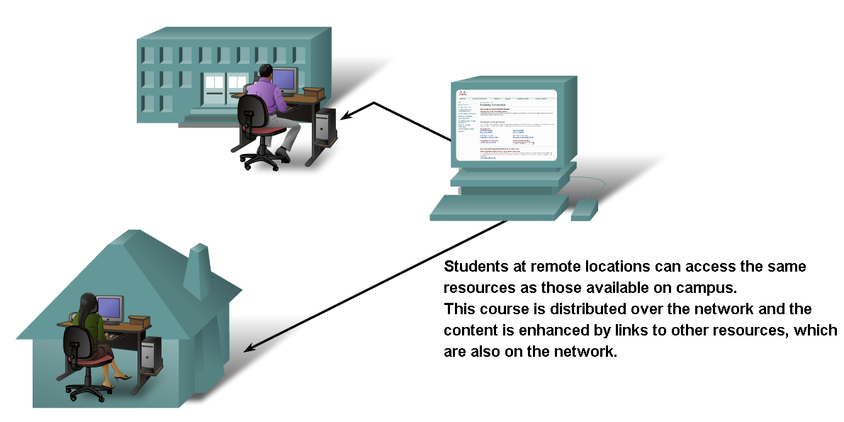
How Networks Impact Daily Life

Slide 5
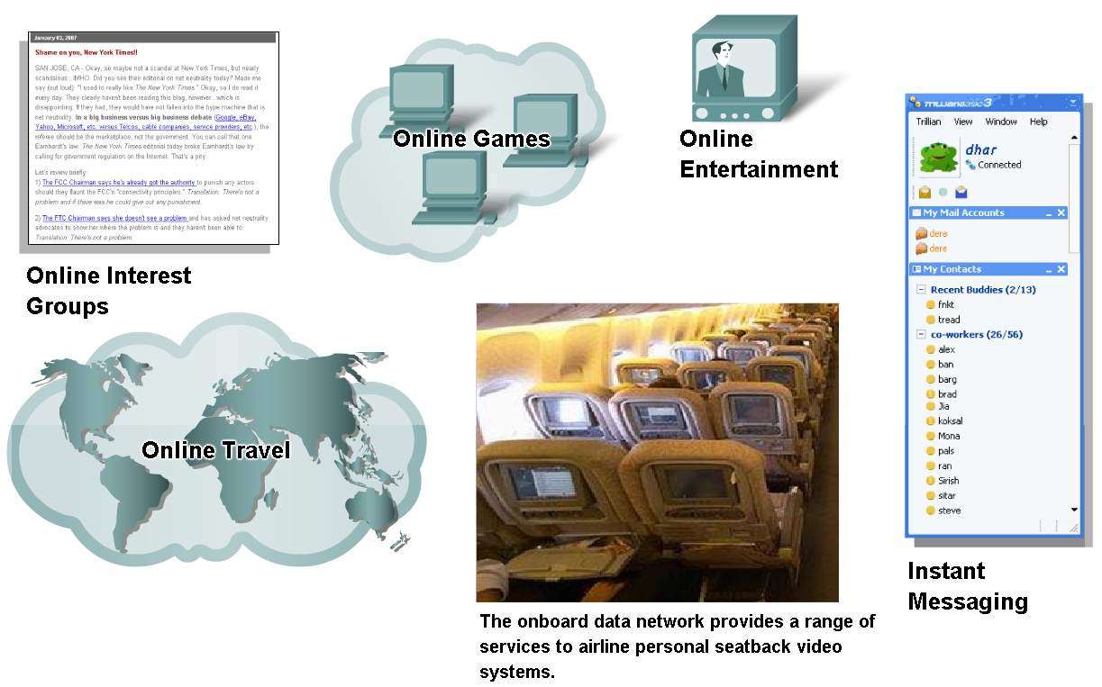
How Networks Impact Daily Life
Communication over a network supports the way we play

Slide 6
History of the largest network – the Internet.
1: Packet switching invented by Paul Baran at RAND.
2: In 1957, the Soviet Union launched the first satellite, Sputnik I, triggering US President Dwight Eisenhower to create the ARPA agency. APRA built APRANET.
3: In 1990, the ARPANET was retired and transferred to the NSFNET. The NSF opened up the network to commercial entities that has led to the present day internet.
See: History of the Internet

Slide 7
Internet is largest network – network of networks.
Age of
eCommerce
Begins
1995
Mosaic
Created
1993
A Brief Summary of the Evolution of the Internet
WWW
Created
1989
Internet
Named
and
Goes
TCP/IP
1984
TCP/IP
Created
1972
Marc Andreessen
ARPANET
1969
Tim Berners-Lee CERN
Hypertext
Invented
1965
Jack Kilby Texas Inst.
Packet
Switching
improved
1964
Kahn and Cerf
First Vast
Computer
Network
Envisioned
1962
Lawrence Roberts
Silicon
Chip
1958
Ted Nelson
A
Mathematical
Theory of
Communication
1948
Donald Davies NPL
Claude Shannon Bell Labs/MIT
1945
1995

Slide 8
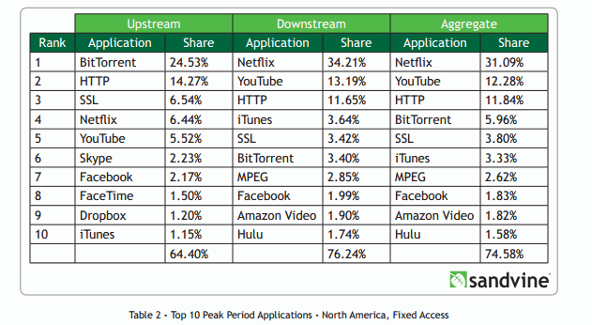
Internet Traffic Volumes
Global internet traffic volume 2014 is approx. 62 Exabytes per month –
1 exabyte = 1 billion tera bytes – if stored on a CD stack it would reach the moon in less than 3 months!!

Slide 9
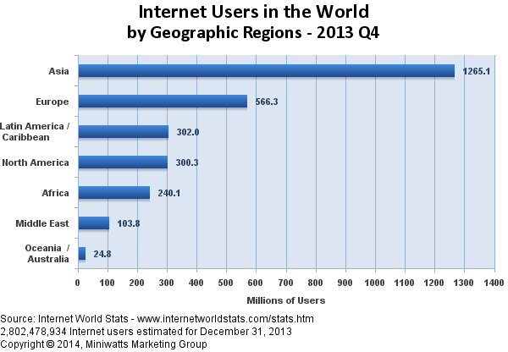
In 1995 there were only 16 million users – 0.4% of worlds population.
Today there is nearly 3 billion users of the internet – 41% of the worlds population.

Slide 10
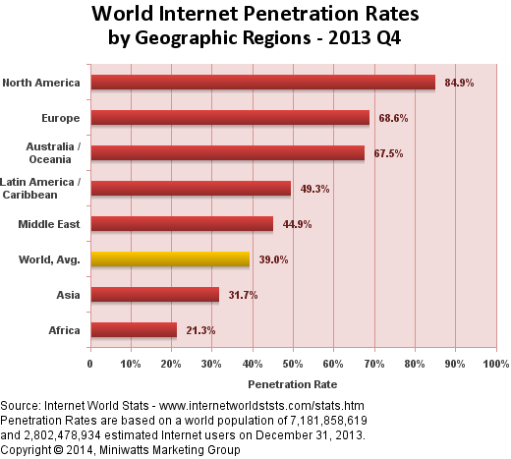

Slide 11
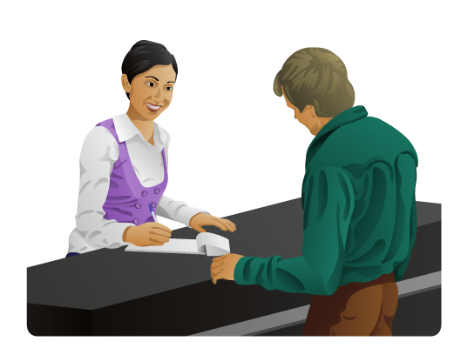
Data Networking Role, Components, and Challenges
Basic characteristics of communication – need rules - Protocols
Rules or agreements are 1st established
Important information may need to be repeated
Various modes of communication may impact the effectiveness of getting the message across.

Slide 12
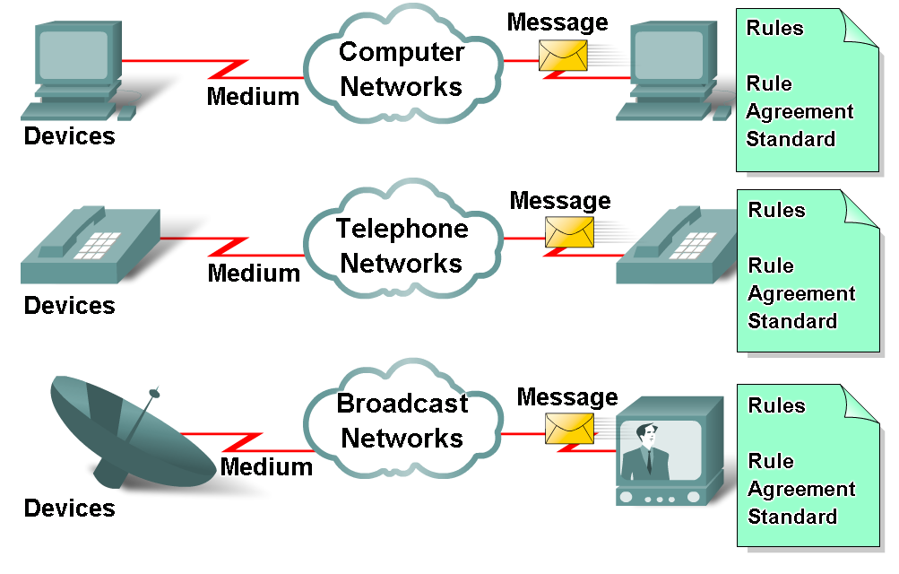
Data Networking Role, Components, and Challenges
The various elements that make up a network
Devices
These are used to communicate with one another
Medium
This is how the devices are connected together
Messages
Information that travels over the medium
Rules - Protocols
Governs how messages flow across network

Slide 13
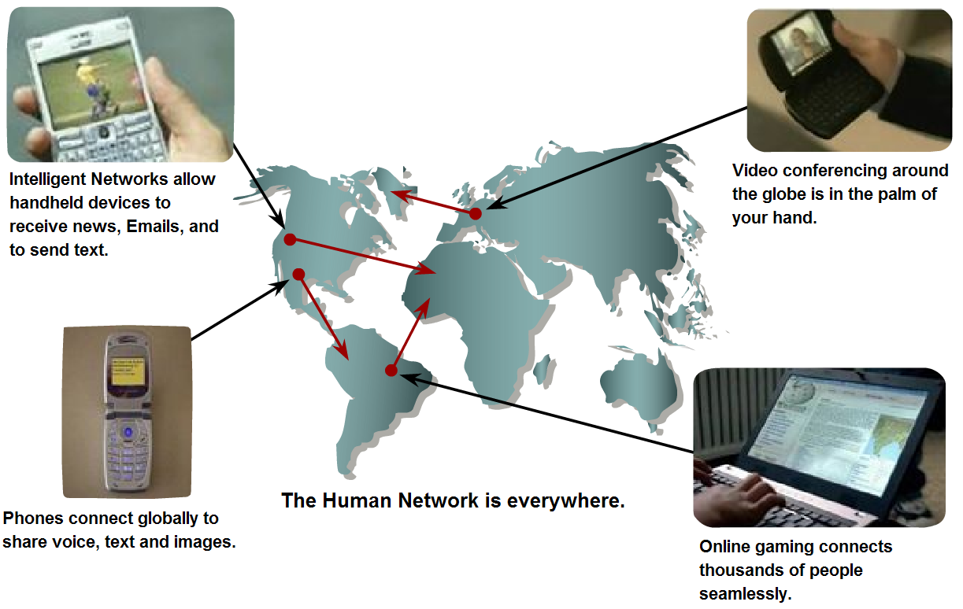
Data Networking Role, Components, and Challenges
Converged network
A type of network that can carry voice, video & data over the same network

Slide 14
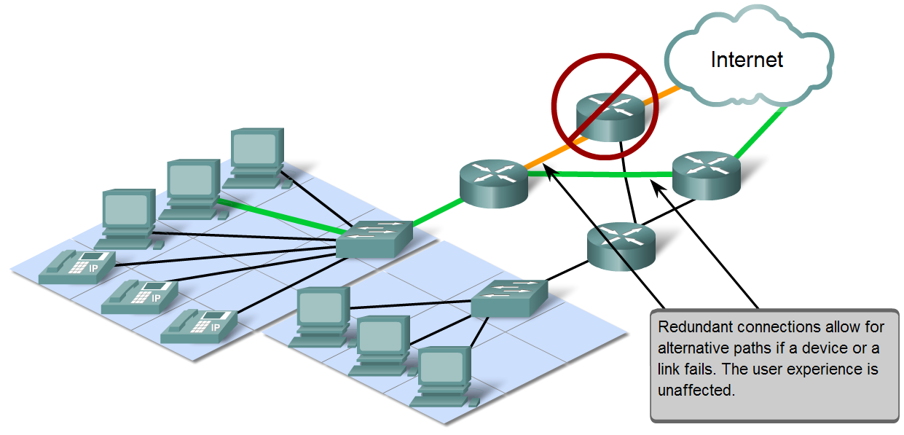
Network Architecture Characteristics
Characteristics that are addressed by network architecture design are
Fault tolerance
Scalability
Quality of service
Security

Slide 15
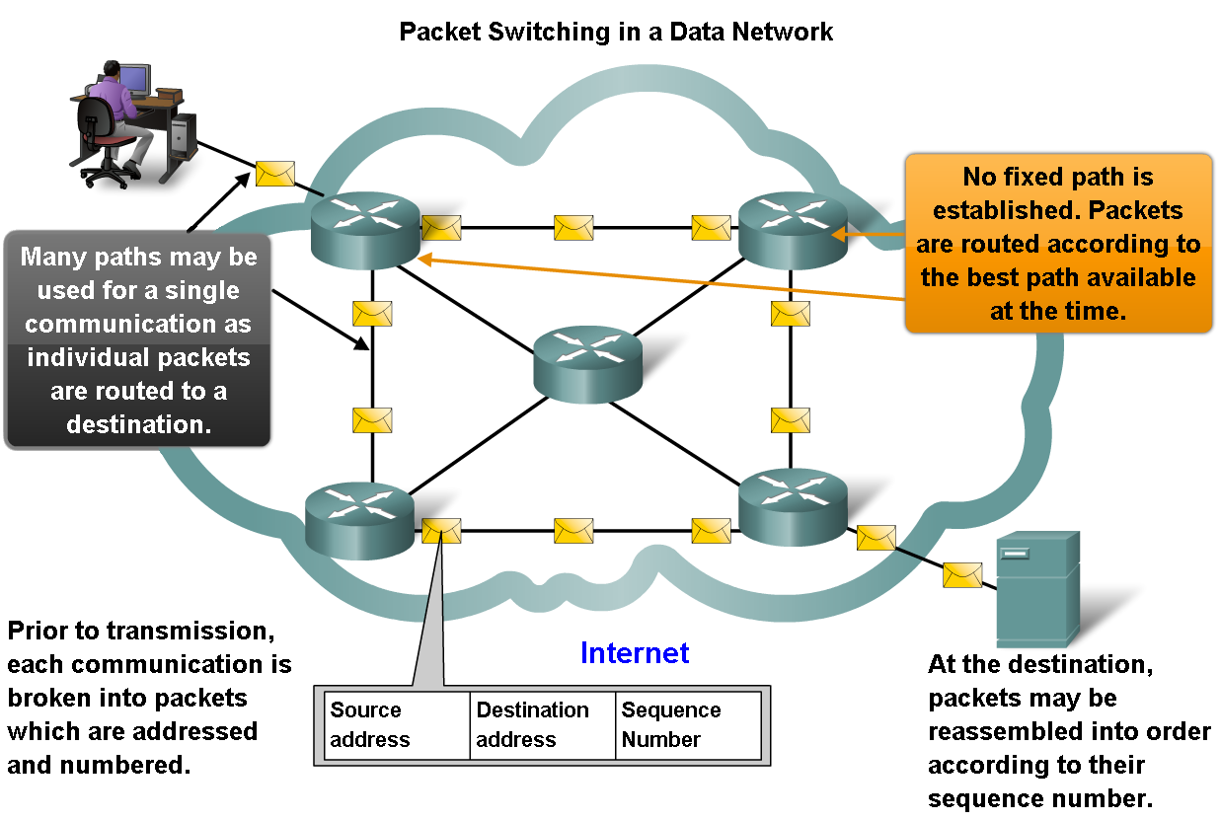
Network Architecture Characteristics
Packet switching helps improve the resiliency and fault tolerance of the Internet architecture

Slide 16
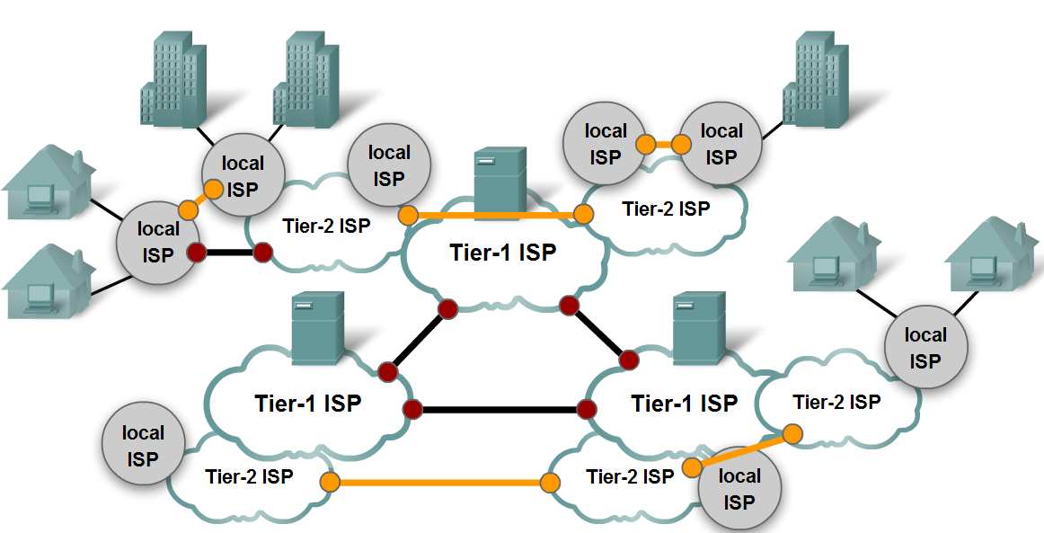
Network Architecture Characteristics
Characteristics of the Internet that help it scale to meet user demand are
Hierarchical
Common standards
Common protocols

Slide 17
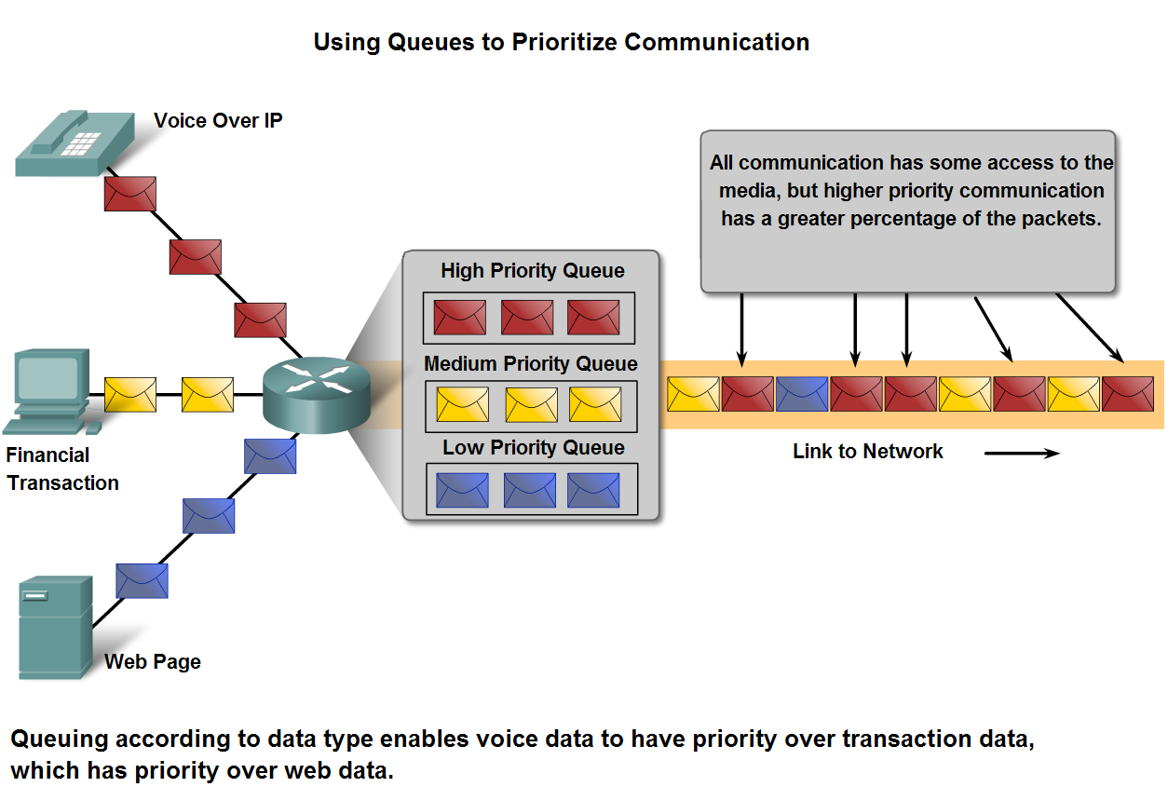
Network Architecture Characteristics
Quality of Service and the mechanisms necessary to ensure it,

Slide 18
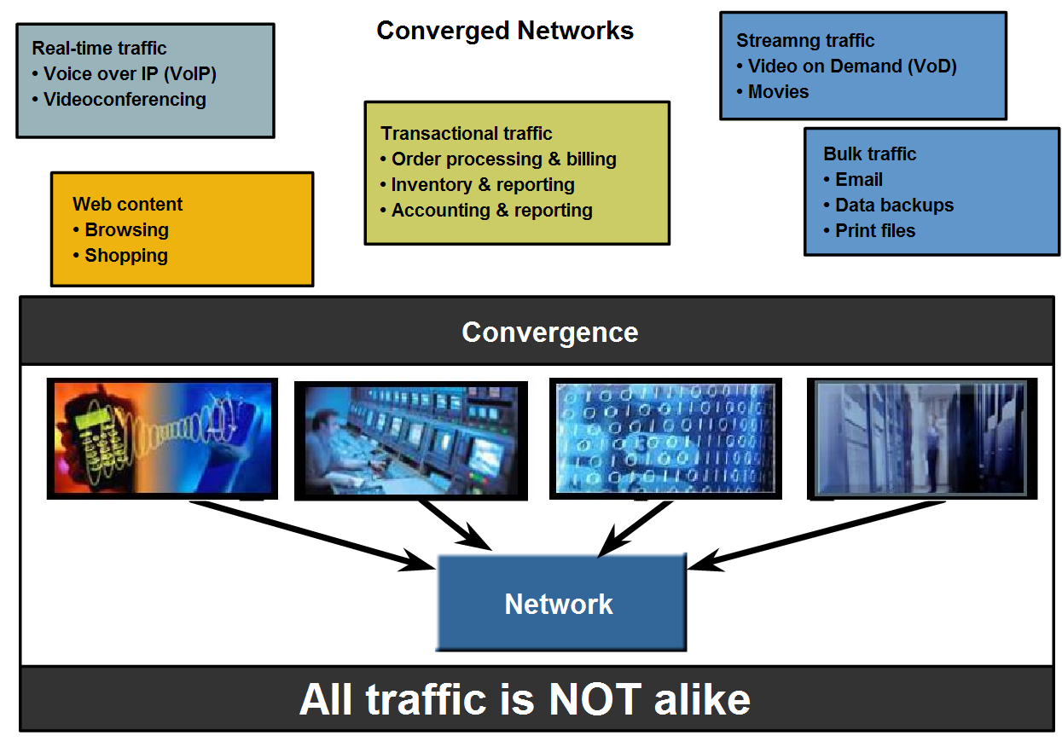
Network Architecture Characteristics
QoS mechanisms work to ensure quality of service for applications that require it.

Slide 19
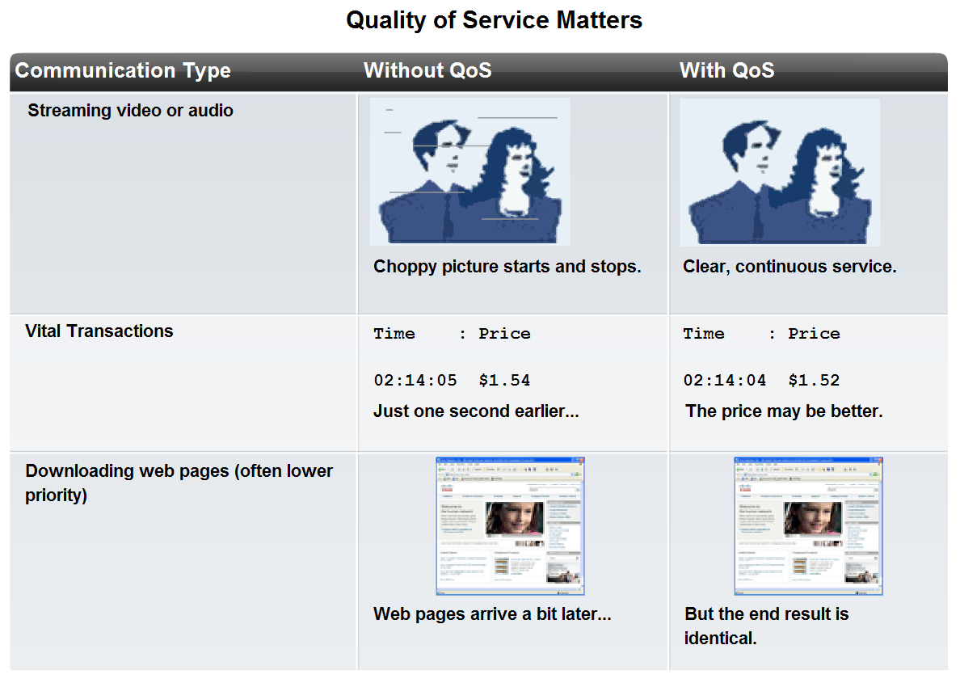
Network Architecture Characteristics
Describe how to select the appropriate QoS strategy for a given type of traffic

Slide 20
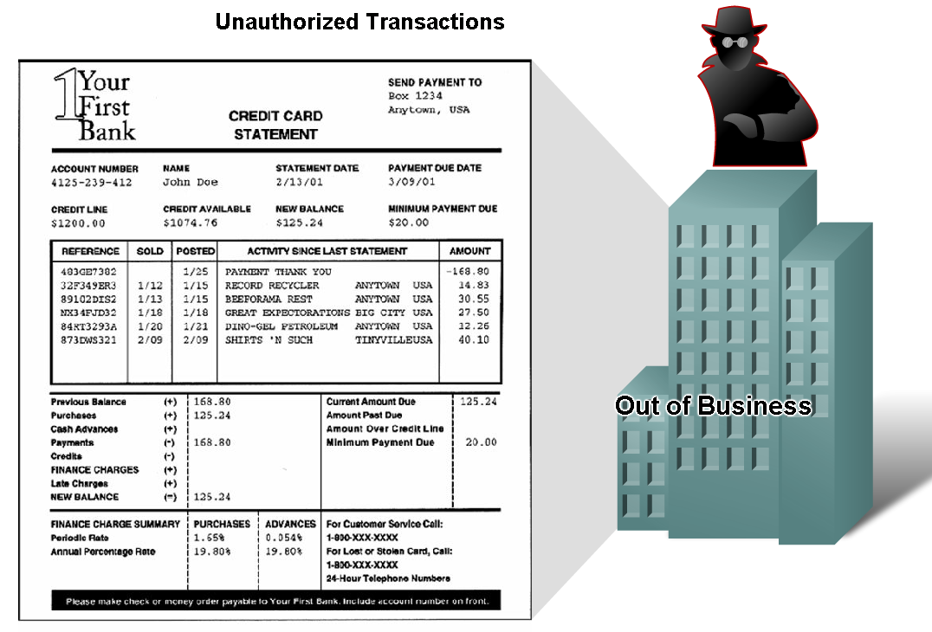
Network Architecture Characteristics
Networks must be secure

Slide 21
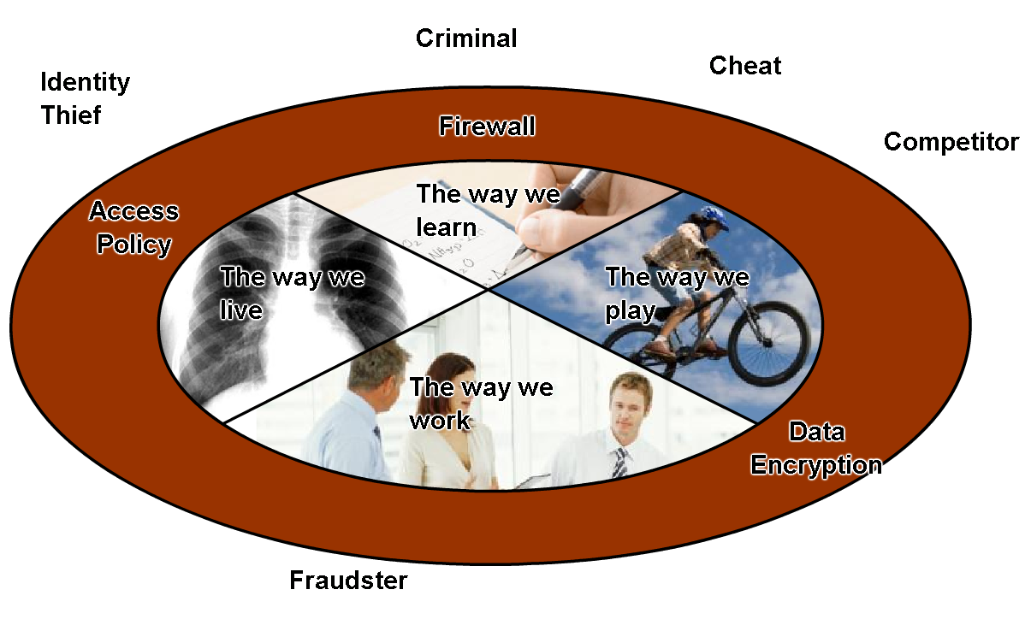
Network Architecture Characteristics
Basic measures to secure data networks
Ensure confidentiality through use of
User authentication
Data encryption
Maintain communication integrity through use of
Digital signatures
Ensure availability through use of
Firewalls
Redundant network
architecture
Hardware without a single
point of failure

